Slide 2
THE DISCIPLES RELATIONSHIP:
TO HIMSELF
An Athlete
A Soldier
TO HIS LORD
The Potter and the Clay
The Vine and the Branches
A Child of God
TO HIS BRETHREN
A Member of the Body
“My Brother’s Keeper”
A Servant
TO THE WORLD
Strangers & Pilgrims
Salt & Light
An Apologist
Fishers of Men

Slide 3
LESSON 4: The Potter and the Clay The Disciple’s Transformation
“Can I not, O house of Israel , deal with you as this potter does?” declares the LORD. “Behold, like the clay in the potter’s hand, so are you in My hand, O house of Israel.” (Jeremiah 18:6)

Slide 4
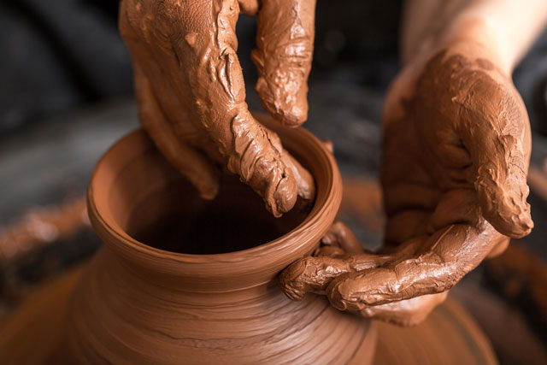
The Disciples Transformation
God is the Potter
Disciples are the Clay
Molded by the Lord’s Teaching
Molding is a process
Molding has a Purpose

Slide 5
The Disciples Transformation
God is the Potter
Disciples are the Clay
Molded by the Lord’s Teaching
Molding is a process
Molding has a Purpose
“…who are you, O man, who answers back to God? The thing molded will not say to the molder, “Why did you make me like this,” will it? Or does not the potter have a right over the clay, to make from the same lump one vessel for honorable use and another for common use?” (Rom. 9:20-21)

Slide 6
The Disciples Transformation
God is the Potter
Disciples are the Clay
Molded by the Lord’s Teaching
Molding is a process
Molding has a Purpose
“Submit therefore to God…Humble yourselves in the presence of the Lord, and He will exalt you.” (Jam. 4:7a, 10)
“…in humility receive the word implanted, which is able to save your souls.” (Jam. 1:21)

Slide 7
The Disciples Transformation
God is the Potter
Disciples are the Clay
Molded by the Lord’s Teaching
Molding is a process
Molding has a Purpose
“And do not be conformed to this world, but be transformed by the renewing of your mind, so that you may prove what the will of God is, that which is good and acceptable and perfect.” (Rom. 12:2)
“transformed” = Gk. “metamorphoo” – to change into another form (Eng. Word “metamorphosis”)

Slide 8
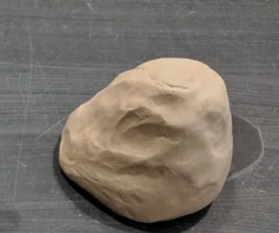
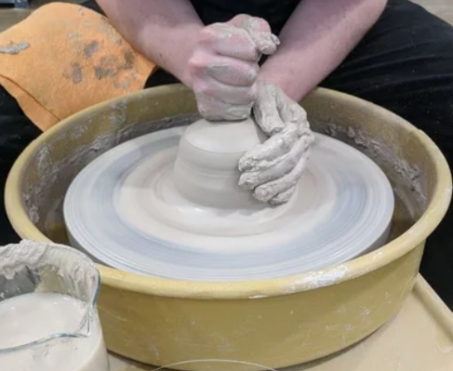
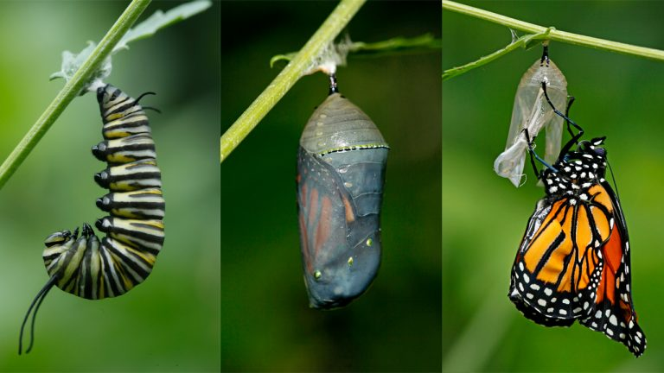
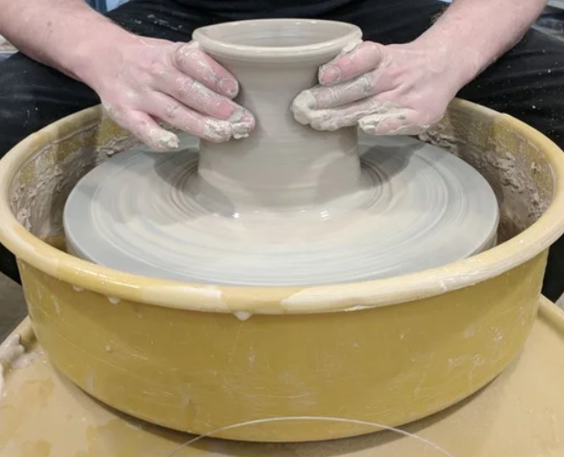
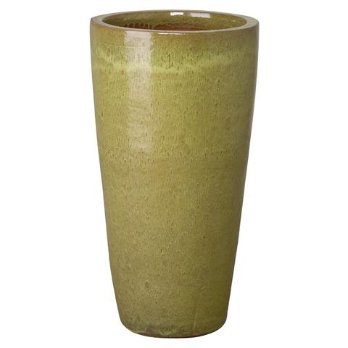
The Disciples Transformation

Slide 9
The Disciples Transformation
God is the Potter
Disciples are the Clay
Molded by the Lord’s Teaching
Molding is a process
Molding has a Purpose
“And do not be conformed to this world, but be transformed by the renewing of your mind, so that you may prove what the will of God is, that which is good and acceptable and perfect.” (Rom. 12:2)
Gal. 4:19; Eph. 3:14-21; Col. 3:9-10; 1John 2:6; Eph. 4:23-24; Tit. 3:5; Matt. 28:18-20; 2Tim. 3:16-17

Slide 10
The Disciples Transformation
God is the Potter
Disciples are the Clay
Molded by the Lord’s Teaching
Molding is a process
Molding has a Purpose
Phil. 3:12-16; Col. 1:9-10;
Jam. 1:2-4; 2Pet. 1:5-8
“But the vessel that he was making of clay was spoiled in the hand of the potter; so he remade it into another vessel, as it pleased the potter to make.” (Jer. 18:4)
“…a man after His own heart…” (1Sam. 13:14)
“…I exhort the elders among you, as your fellow elder…” (1Pet. 5:1)

Slide 11
The Disciples Transformation
God is the Potter
Disciples are the Clay
Molded by the Lord’s Teaching
Molding is a process
Molding has a Purpose
“Therefore, if anyone cleanses himself from these things, he will be a vessel for honor, sanctified, useful to the Master, prepared for every good work.” (2Tim. 2:21)
“For we are His workmanship, created in Christ Jesus for good works…” (Eph. 2:10)

Slide 12
The Potter & The Clay
Do you make demands of the Potter? If so, do you have a proper understanding of God’s mercy?
Are you renewing your mind? Or are you conformed to this world?
Are you working on being “filled up to all the fullness of God?” Or is your cup already full?
What will you do this week to become more soft and malleable for the Lord?

